Slide 1
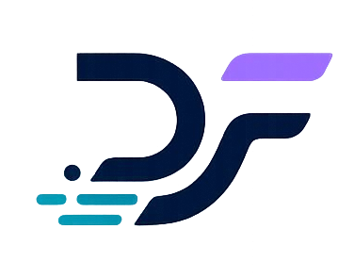
DealForge Project Proposal
Agentic AI Bootcamp (Online 2)

Slide 2




Meet Our Team
Amira Aljuaid
MS.c in AI
Asrar Fallatah
BS.c in Computer Engineering
Ruwaa Surrati Shahad Alharbi
B.S. in AI
BS.c in Computer Science

Slide 3
Agenda
01
02
03
Introduction
Pain Points
Proposed Solution
04
05
06
Market Research
Target Users
Conclusion & Future Work

Slide 4


Introduction
This project proposes the development of a DealForge designed to help sales teams manage leads, customers, deals, follow-ups, and sales reports through natural language chat or voice.
Instead of using traditional CRM screens and forms, the user can simply write or say a sales update, and the AI agent will extract the important information, structure it, ask for confirmation, and update the CRM database.

Slide 5

Pain Points
Manual Data Entry
Too much time spent updating customer and sales information manually
Delayed CRM Updates
CRM records are often updated late or forgotten entirely
Incomplete Customer Records
Missing important customer and deal information
Inconsistent Data
Different employees use different formats and labels for the same data

Slide 6

Pain Points
Complex CRM Interfaces
Traditional CRM systems can be difficult and overwhelming to use
Manual Reporting
Preparing sales reports manually delays insights and decision-making
Diﬃculty Retrieving Past Interactions
Searching through previous calls, emails, and notes is time-consuming
Costly Enterprise CRM Tools
Existing CRM platforms may be too expensive for small businesses

Slide 7
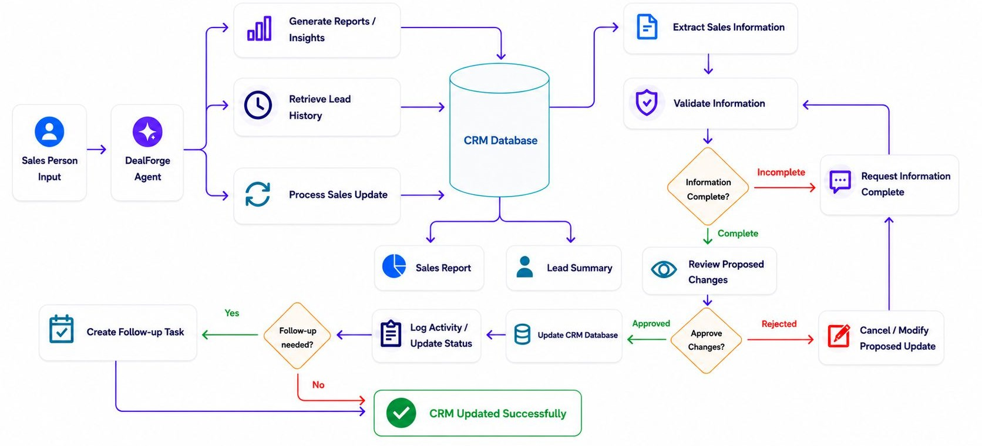
Proposed Solution-Workflow

Slide 8


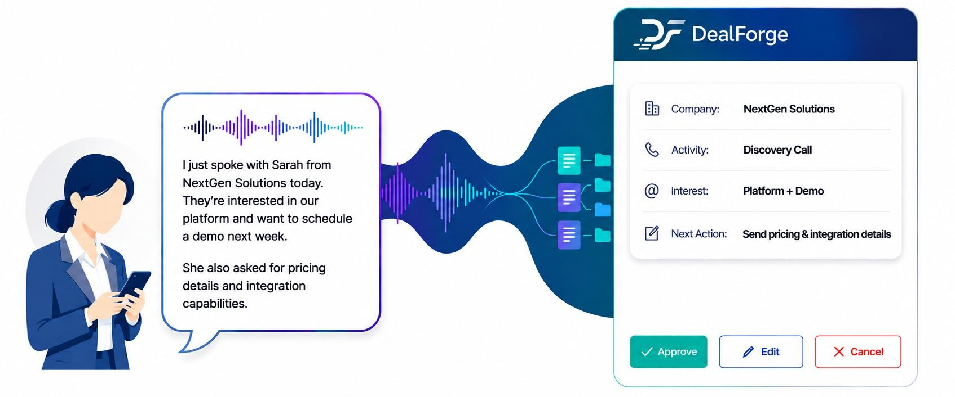
Proposed Solution-Example
The proposed solution is a AI CRM Agent that works through chat or voice

Slide 9
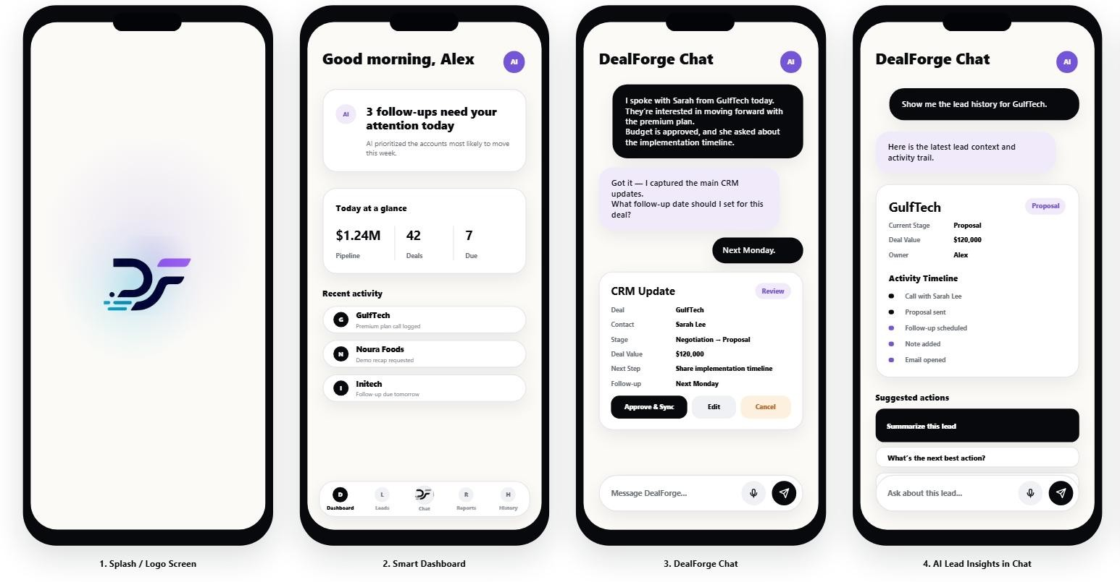
Proposed Solution-UI

Slide 10
Market Research
Has this been implemented before?
CRM Platform | AI Feature
Salesforce | Einstein AI for automation and sales insights
HubSpot | AI tools for email generation and chatbot support
Zoho | Zia AI for predictions and conversational assistance
Microsoft Dynamics 365 | AI Copilot for customer summaries and automation
Freshsales | AI-powered lead scoring and recommendations
Most CRM systems still rely on complex dashboards and manual workflows
Existing platforms can be expensive and difficult for SMEs
Limited conversational and headless CRM experiences

Slide 11
Market Research
Why is our solution different?
Fully conversational experience using chat or voice instead of traditional CRM screens
Headless architecture that can integrate with multiple platforms and communication channels
Designed specifically for small and medium businesses that need a lightweight and affordable solution

Slide 12
Market Research
Why is our solution different?
Provides real-time follow-up tracking and instant sales reporting.
.
Reduces manual data entry and improves CRM data consistency
Automatically extracts and structures sales information from natural language.
Easier adoption for non-technical users compared to enterprise CRM systems.

Slide 13



Target Users
Small and medium business sales team
Startup founders managing customer relationships
Freelancers and consultants handling multiple clients
Sales representatives and account managers
Non-technical users who struggle with complex CRM systems

Slide 14





Project Timeline
Week 2
AI Agent Integration
Week 4
Testing & Demo
NLP
Tool calling
CRM backend integration
System testing
UI polishing
Final presentation demo
Week 1
System Foundation
Week 3
Intelligence Layer
CRM database design
API development
Simple dashboard UI
RAG
Conversation memory
Auto-generated sales reports

Slide 15
Conclusion
DealForge simplifies CRM management through natural language interaction. The solution helps sales teams reduce manual work, improve data accuracy, manage follow-ups efficiently, and generate faster sales insights. It demonstrates how AI agents can enhance productivity and user experience in sales operations.

Slide 16
Future Work
Integration with existing CRM platforms such as Salesforce and HubSpot
Sentiment analysis
Multi-Language Support

Slide 17


Thank You
Do you have any questions?
CREDITS: This presentation template was created by
Slidesgo, and includes icons by Flaticon, and infographics & images by Freepik

